Slide 1


PRATHYUSHA ENGINEERING COLLEGE DEPARTMENT OF COMPUTER SCIENCE AND ENGINEERING
Performance monitoring of servers with Augmented Reality
Internal Guide
Team Members
Vishal.M (111418104111)
DR.V.Vijaya Raja
Assistant Professor
Thamarai Selvan.G
(111418104102)
Prashanth.S
(111418104081)

Slide 2
Introduction
Monitoring the server and its performance is crucial for an organization. If the organization merely depends on the servers to run their operations, so if the server faces any issues it might cause some loss.
Usually to monitor server and its parameters is done via a PC.
The main principle of this project is to visualize the parameters and monitor the performance of the servers remotely via a mobile application and visualize parameters in AR
With this data the end user can monitor the performance of individual servers and visualize its parameters like CPU utlization, Memory Utilization, Latency e.t.c
If a particular server faces any issues the technical team can raise a support request and this can be viewed by Server Admin if that particular servers QR is scanned.

Slide 3
Abstract
Generally to monitor a server the admin should visit the server site and use the PC connected with the servers.
If the server admin want to monitor a particular server he has to visit the PC.
With the help of our application the admin can easilly analyze and monitor the server parameters in the server room itself.
Upon opening our app there will be a list of servers and its current status, so that when a ticket is raised from the technical team the admin can monitor that particular server within our app.
Suppose the admin is on server site he can scan the QR code and visualize the server parameter in Augumented Reality.
If the firm has multiple servers across multiple geographical locations they visualize the all servers in Map format and its parameters too.

Slide 4
Existing Method
Currently to monitor the server performance or other parameters quickly the server admin has to use a PC.
Moreover if the admin is near to the server and has to monitor it he has to visit the PC again
If the firm has multiple server across geographical location it is difficult for them to monitor.
If a ticket is raised regarding any problem with a particular server it will be difficult for the admin to pin point the server and the admin can forget to resolve the issue.

Slide 5
Proposed Method
Our proposed system will a mobile application which will present the user with a dashboard which will list the servers present along with its status.
Now the admin can easily monitor the server by clicking any particular server and view its parameters. The admin can also view the parameters in graph format too.
Since our system has augumented reality, the admin can scan the QR present the near the server and visualize the particular server parameter in AR and does not need to visit the PC.
If the firm has multiple server across geographical location, they can easily visualize the server in map format in AR along with its necessary parameters.
If a ticket is raised regarding any problem with the particular server it will be notified in the app in the server section and the admin can reply to the team if the issue is resolved. It can also be visualized if that particular server QR is scanned.

Slide 6
Literature Survey
Title & Author | Date | Advantages | Disadvantages
Information System Access Log Database on Database Server: A Setiyadi and E B Setiawan 2019 IOP Conf. Ser.: Mater. Sci. Eng. 407 012110 | 2019 | The author have provided information about the benefits of this system for flexibility and speed | The author logs the performance to a log not in real time.
Server Utilization-Based Smart Temperature Monitoring System for Cloud Data Center: Sudipta Sahana, Rajesh Bose, Debabrata Sarddar, 21 July 2019 | 2019 | The author collects the physical paramters in real time. | The author logs only server physical parameters like temperature.

Slide 7
Literature Survey
Title & Author | Date | Advantages | Disadvantages
Sulasno, Sulasno & Saleh, Rakhmat & Savitri, Intan. (2021). Developing Integrated Smartphones Notification of Server Resource System Using Zabbix, Webhook, and Telegram. JUITA: Jurnal Informatika. 9. 191. | 2021 | The author sends real time notification to the user | The author uses Zabbix platform which is complex to setup.
Swapnil H Sonawane, Swati M Khandare, Shruti Patil, ITSM Based Server System: Vol. 2 No. 3 (2021): March | 2021 | The author uses ITSM platform which is widely used by IT industries | Since ITSM can be only viewed in PC the data cannot be accessed quickly.

Slide 8
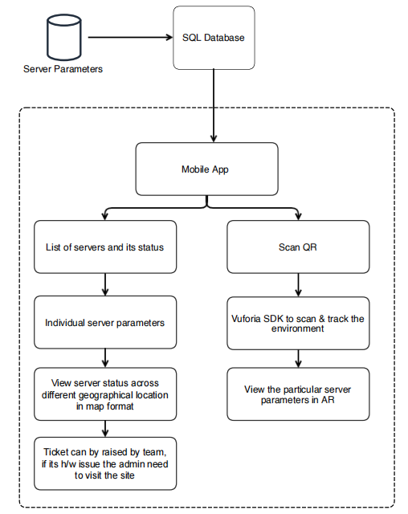
System Architecture Diagram

Slide 9
Description of System Architecture Diagram
First the parameters of the server will be sent to DB like SQL or Firebase
After opening our application it will show the list of servers and its status which will be obtained from Perf Monitoring running from server end.
User can either view the detailed parameters of the server or click scan QR to view it in AR using Vuforia SDK.
User can also view the parameter of servers across differnet geographical location in map format
Technical team can raise ticket and the admin can see within the app.

Slide 10
Modules
Dashboard: Upon opening our app a dashboard will be display along with the list of servers and its status.
Server Parameters: If the user clicks the particular server in the list, they will be displayed detailed parameters of the server.
Map View: This will visualize all the connected servers across different locations in a map format in AR
Scan QR: The admin can scan the QR of a particular server and visualize its parameters in realtime in AR.
Ticket viewer: Admin can view any ticket raised by the team and reply within the app and resolve it. Based on the status and paramters of the server the admin can come to a conclusion if its a hardware or other issues like high traffic, high load e.t.c

Slide 11
Module Implementation
Dashboard (First Module):
The first module which is the dashboard module works from fetching data from the backend server running in background. The backend server is built using Python with pandas library to fetch CSV values of the performance parameters and it is send to SQL DB running in Clever cloud.
After pushing the values to SQL DB we fetch the values in our Mobile App using JSON parse using Volley Library and display it the app dashboard which updates in Real time.

Slide 12
References
[1] Zlatkovski, Dragi and Mileva, Aleksandra and Bogatinova, Kristina and Ampov, Igor (2019) A New Real-Time File Integrity Monitoring System for Windows-based Environments. In: ICT Innovations 2018, September 17-19, 2018, Ohrid, Republic of Macedonia.
[2] Jitin Chadha, PSTA, Performance Monitoring Windows Server: PerfMon, IEEE Journal, Oct-2020
[3] Federated Windows Datasets for monitoring Applications, 2020 IEEE 19th International Conference on Trust, Security and Privacy in Computing and Communications (TrustCom), 2020, pp. 848-855, doi: 10.1109/TrustCom50675.2020.00114.

Slide 13
Thank You

